Slide 1
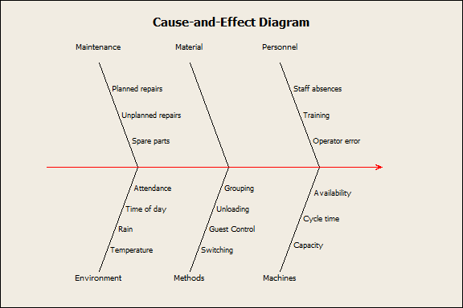
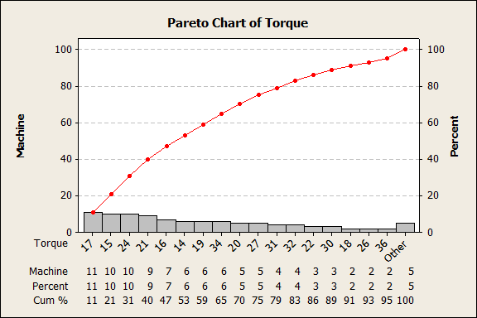
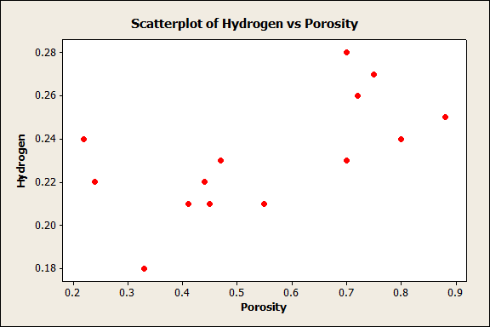
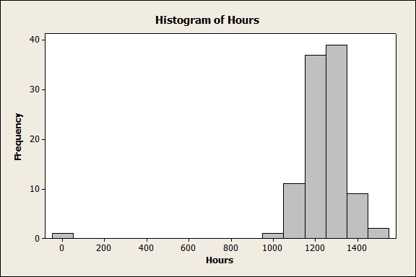
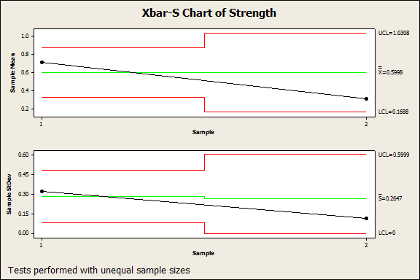
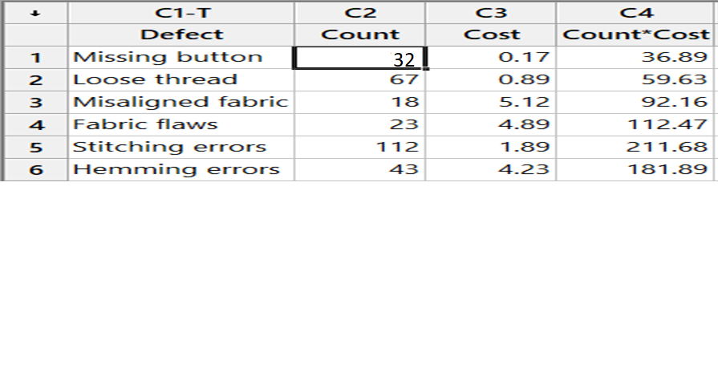
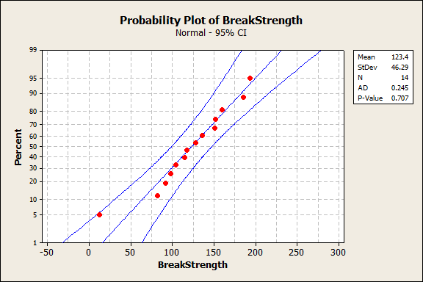
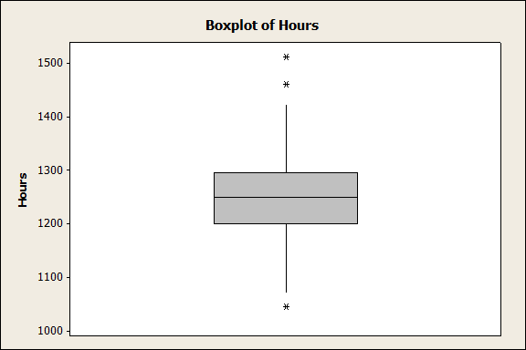
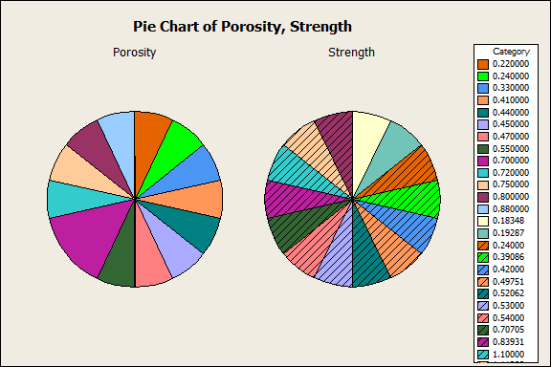
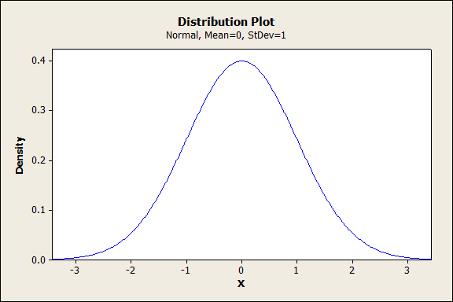
A
A.S.M MASHRUR ASHKER
ID:201636032
IPE-01
Level-03
Exploratory Data Analysis Using Minitab
MINITAB has many advantages for statistics, for example it save time when we are interested in making basic descriptive statistics for a large size sample, conducting hypotheses testing, writing a statistical report and scanning given data. For These data analysis
h
Cause & Effect Diagram
Pareto Chart Of Torque
Scatterplot Of Hydrogen Vs
Porosity
Histogram of hours
Stat -use this menu to analyze data. This key menu performs many useful statistical functions Regression submenu: MINITAB has a Regression submenu in Stat to perform the analyses. Graph -use this menu to graphically represent the data. Editor -use this menu to edit and format the data. Some Other features are quality tools, control chart etc.
Bubble Plot Of City MPG Vs Hwy MPG Bubble Size
Xbar-S Chart of strength
Probability plot Pf Break Strength
Boxplot of Hours
Pie Chart
Distribution Plot

